Slide 1




Constraining VOC emission from western US wildfires with WE-CAN and FIREX-AQ airborne observations
Lixu Jin, Wade Permar, WE-CAN team, FIREX-AQ team, and Lu Hu
University of Montana
Email: lixu.jin@umconnect.umt.edu

Slide 2
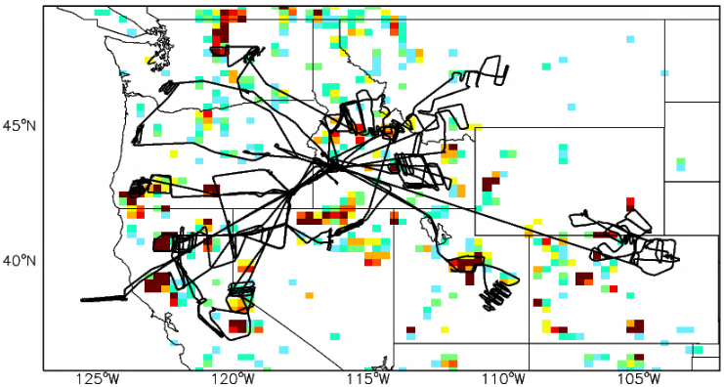
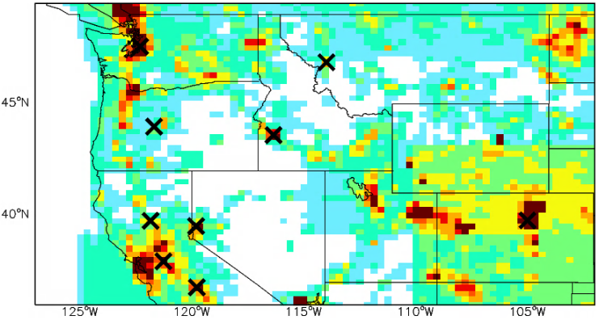
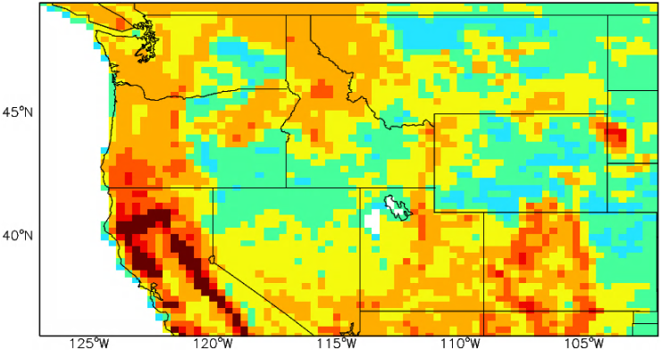
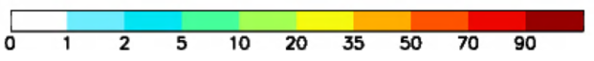
Current understanding of primary VOC emission in 2018 Summer
Biomass burning (GFAS)
Anthropogenic (EPA NEI 2011)
242 GgC or 8%
405 GgC or 14%
Biomass burning/Anthropogenic
Biogenic (MEGAN)
Biogenic
[1e12 atomsC/cm2/s]
The total VOC emissions diff by 30-40% across 3 widely used BB emission inventories for this region (GFED4, QFED, and GFAS).
In the 2019 fire season, the VOC BB emission is only 1/6 of that in 2018 for this region.
2272 GgC or 78%

Slide 3
Current understanding of primary VOC emission in 2018 Summer
Biomass burning (GFAS)
Anthropogenic (EPA NEI 2011)
242 GgC or 8%
405 GgC or 14%
GEOS-Chem suggests that biomass burning (BB) only account for <10% of the primary VOC emission in the western US. Is it true?
Biomass burning/Anthropogenic
Biogenic (MEGAN)
Biogenic
[1e12 atomsC/cm2/s]
The total VOC emissions diff by 30-40% across 3 widely used BB emission inventories for this region (GFED4, QFED, and GFAS).
In the 2019 fire season, the VOC BB emission is only 1/6 of that in 2018 for this region.
2272 GgC or 78%

Slide 4

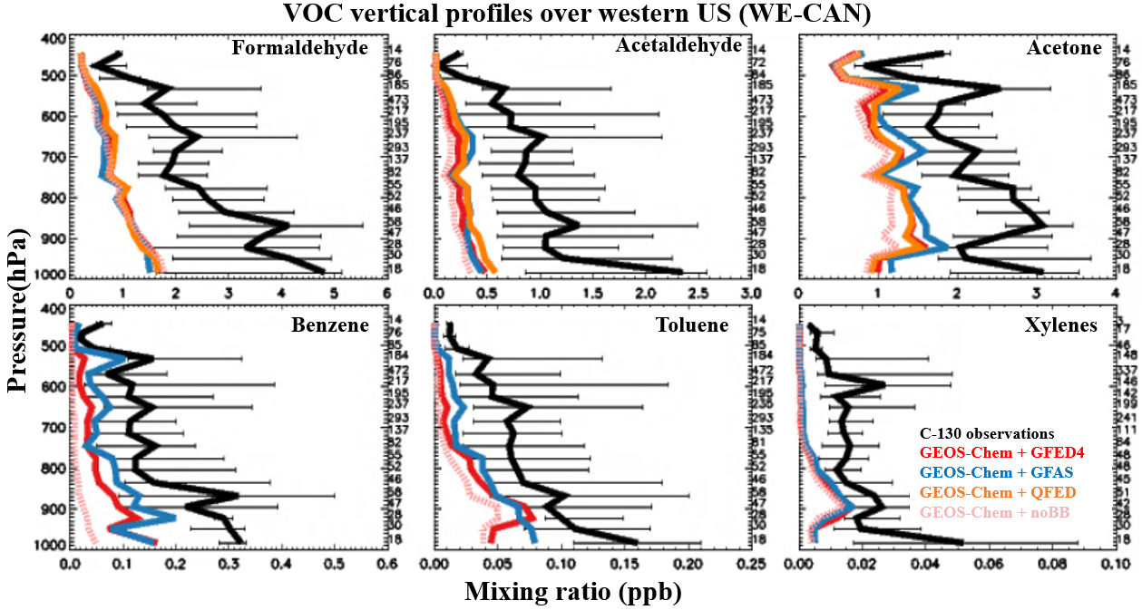

Mod vs mod: GEOS-Chem + GFAS tends to reproduce higher and better VOCs mixing ratios.
Mod vs obs: GEOS-Chem with different inventories can reproduce the BB enhancements in the campaign averaged profiles but systematically underpredict observed VOC abundance by a factor of 2-6.
VOC vertical profiles over western US (WE-CAN)
C-130 observation
GEOS-Chem + GFED4
GEOS-Chem + GFAS
GEOS-Chem + QFED
GEOS-Chem + noBB
Analysis is conducted for other 11 VOCs (not shown here)
Question: Is the negative bias from BB emissions? How much and why?

Slide 5
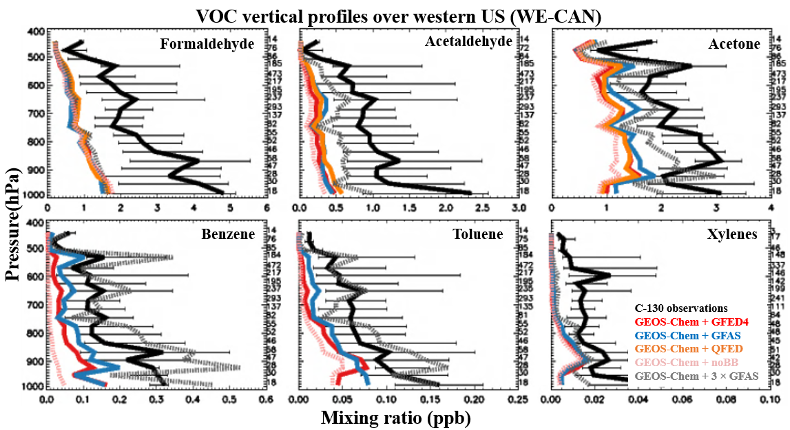
The best-case simulation (GEOS-Chem + GFAS) underestimates the BB emission by a factor of 3-5.
For primary VOCs, tripling BB emissions agree the WE-CAN observation within measurement uncertainty; For OVOCs, there are likely missing photochemical production sources in the model.
VOC vertical profiles over western US (WE-CAN)
C-130 observation
GEOS-Chem + GFED4
GEOS-Chem + GFAS
GEOS-Chem + QFED
GEOS-Chem + noBB
GEOS-Chem + 3 × GFAS
C-130 observation
GEOS-Chem + GFED4
GEOS-Chem + GFAS
GEOS-Chem + QFED
GEOS-Chem + 3 × GFAS
GEOS-Chem + noBB
Question: Why does model underpredict BB emission?

Slide 6
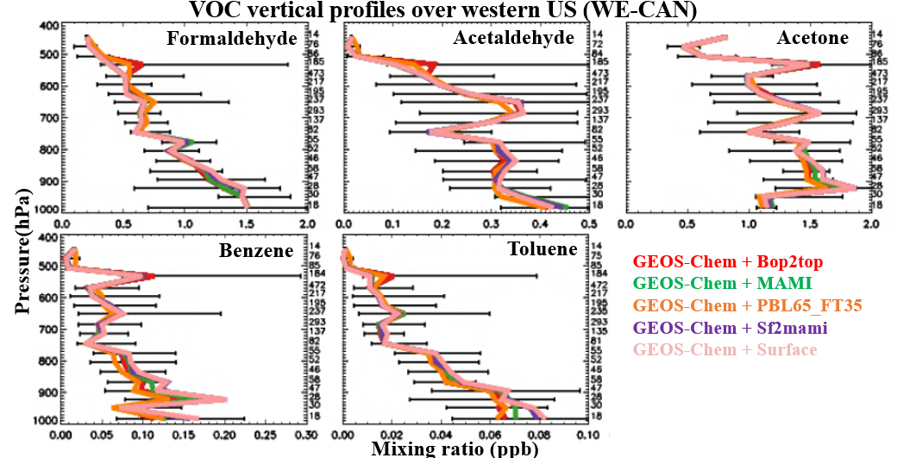
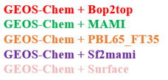

GFAS is selected for BB emission in this sensitivity test.
The GEOS-Chem + Injection experiments tend to agree within 10%, suggesting that GEOS-Chem is not sensitive to those assumptions of how BB emissions are released vertically (at least for observation we used).
VOC vertical profiles over western US (WE-CAN)
Injection height
Data credit:
Jeff Pierce (Bop2top)

Slide 7
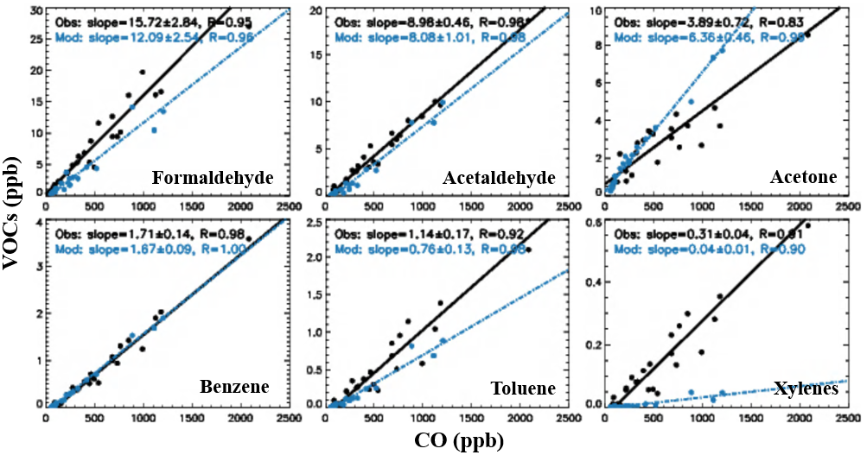
Emission ratio test: the best representation (GFAS) tends to agree observed ER within ± 30 %.
Fire detection experiment suggests the all 3 inventories can detect ~ 30 fires we sampled during WE-CAN.
=> VOC emission ratio and fire detection are not significant model errors in the GEOS-Chem.
VOC vs CO emission ratio (WE-CAN)
VOC vs CO emission ratio (WE-CAN)
Injection height
Emission ratio
Fire detection
Similar analysis is conducted for FIREX-AQ and the conclusions hold.

Slide 8

How does BB emission inventory work?
Simple math: Emission estimates (g) = Emission factor (g/kg dry matter burnt) × dry matter burnt (kg)
Emission ratio and emission factor both suggest similar information.
=> The BB underestimation is driven the underestimation of dry matter burnt.
VOC vs CO emission ratio (WE-CAN)
VOC vs CO emission ratio (WE-CAN)
Injection height
Emission ratio
Fire detection
Dry matter burnt
Similar analysis is conducted for FIREX-AQ and the conclusions hold.
Question: Can the BB underestimation be applied to the widespread western US?
Notes:
Lhu, need to explain why the dry matter burnt is wrong: i.e., low obit satellites doesn’t have enough temporal and spatial resolutions, cloud interferences etc.

Slide 9
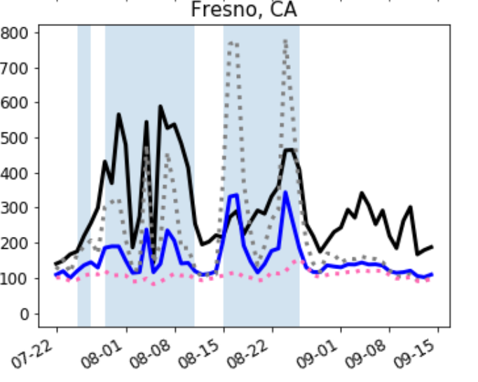
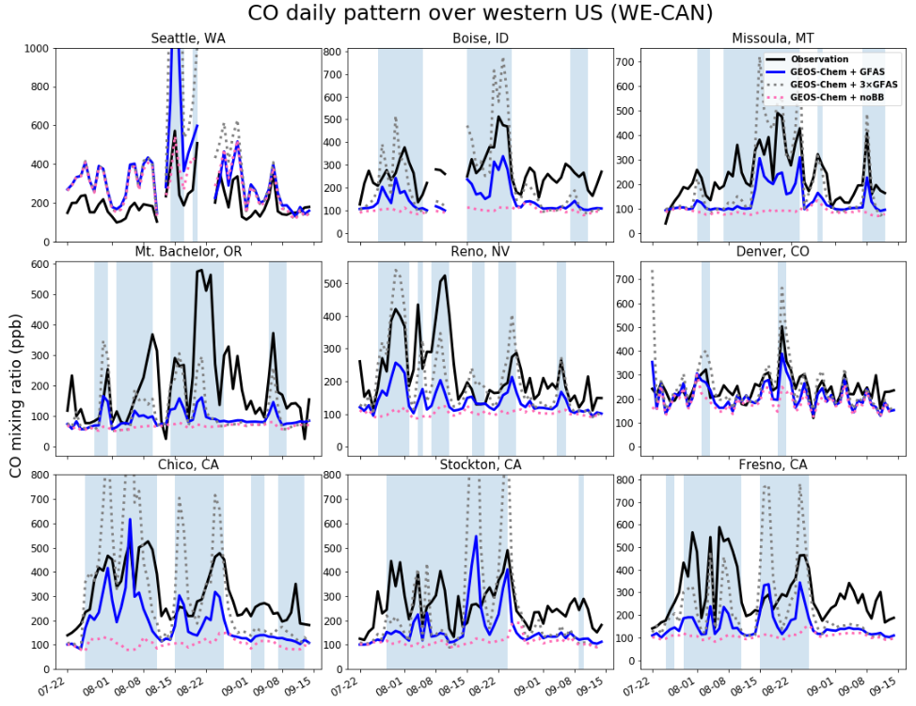
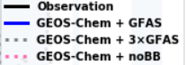
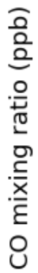
The base model (GEOS-Chem + GFAS) does underestimate BB emissions across western US.
The 3 × GFAS simulation systematically improves the model mean bias across western US for 7 fire-influenced sites without degrading correlation coefficients with observations.
CO mixing ratios time series (WE-CAN)
Observation
GEOS-Chem + GFAS (base)
GEOS-Chem + 3 × GFAS
GEOS-Chem + noBB
Observation
GEOS-Chem + GFAS (base)
GEOS-Chem + 3 × GFAS
GEOS-Chem + noBB
These ground measurements also point to the BB emission underestimation across western US.
Data credit:
Dan Jaffe (Mt Bachelor), Bob Yokelson and Vanessa Selimovic (Missoula), and EPA (rest)

Slide 10
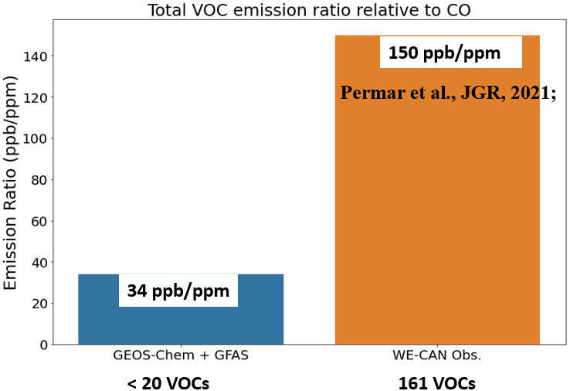
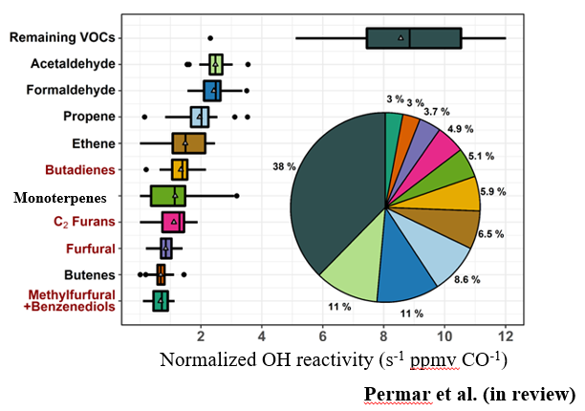
A significant amount reactive carbon from wildfire is missing in the GEOS-Chem
Emission: VOC emission from wildfire can account for 30-60% of the total primary VOC emission (1-8% of total before), considering the dry matter burnt underestimation and unmodeled VOCs.
Chemistry: Among top 10 OH reactivity contributor, 4 of them are not included in the GEOS-Chem: three of them are furans (furan and its derivatives) and the remaining one is butadiene.
< 20 BB VOCs
161 BB VOCs
Thanks Tess for providing a nice background about furans!

Slide 11
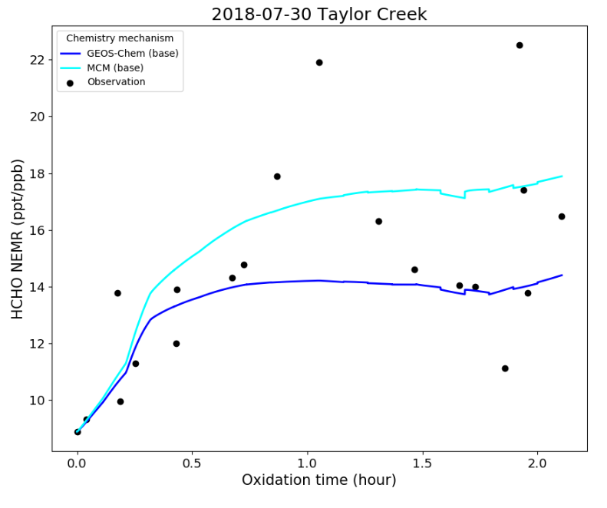


Summary
Conclusions:
Three commonly-used BB inventories underestimate the BB emissions due to underprediction of dry matter burnt in the western US.
Tripling the BB emission (3 × GFAS) systematically improves model: observation comparisons for primary VOCs. However, the model misses photochemical production sources for OVOCs.
BB emissions play a far more important role than previous understanding.
Observation
GEOS-Chem chemical mechanism
Explicit chemical mechanism (MCM)
Future work:
GEOS-Chem chemistry mechanisms miss secondary HCHO production source by comparing to near-explicit chemistry (MCM).
We need to figure out the missing secondary source for formaldehyde.
Also , we will customize chemistry of furans and other VOCs into the GEOS-Chem, due to their significant OH reactivity contribution and corresponding chemical impacts.
To be submitted. Stay tuned!
lixu.jin@umconnect.umt.edu
Twitter: @Lixu_Jin

Slide 12
Additional materials (see following slides)

Slide 13
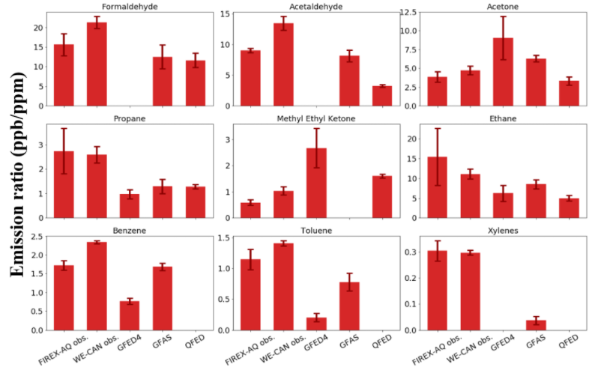
VOC vs CO emission ratio

Slide 14
The model underpredicts the BB emissions by a factor of 3-5 (Q1 and Q2)
Simple math is conducted to derive the underpredicted BB:
BB impacts = full datasets – least fire conditions
Underestimated BB impacts = BB impacts from observation – from model
Model underestimates by a factor of 3-5 for primary trace gases (similar conclusion is gained for the 2019 FIRE-AQ)
Tripling the BB emissions in the model agree observed VOCs within observation uncertainty except xylenes and OVOCs (formaldehyde here).
Why are BB emissions underestimated?
(e.g., emission factors, fuel burned, fire detections, and injections?)

Slide 15
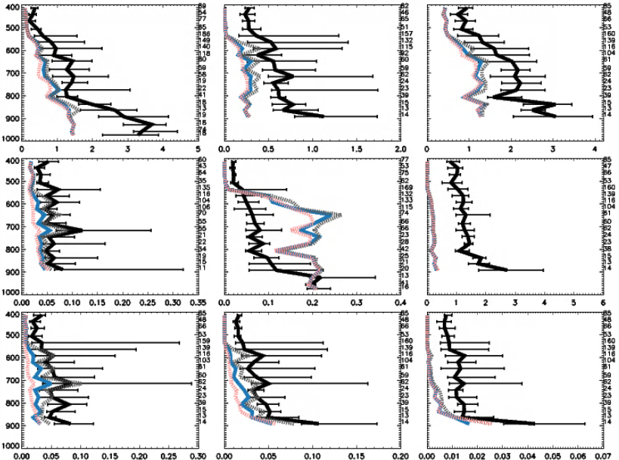
VOCs vertical profiles over the western US (FIREX-AQ)
Formaldehyde
Acetaldehyde
Acetone
DC-8 observations
GEOS-Chem + GFAS
GEOS-Chem + 3 × GFAS
GEOS-Chem + noBB
Propane
MEK
C-130 observations
GEOS-Chem + Bop2top
GEOS-Chem + MAMI
GEOS-Chem + PBL65_FT35
GEOS-Chem + Sf2mami
GEOS-Chem + Surface
Pressure(hPa)
Benzene
Toluene
Xylenes
Mixing ratio (ppb)
Similar conclusion supported by FIREX-AQ: GEOS-Chem + GFAS can reproduce the BB enhancements in the profile but systematically underpredict BB-related source by a factor of 3-6 for primary VOCs (except MEK; a factor of 2-5 in the WE-CAN).

Slide 16
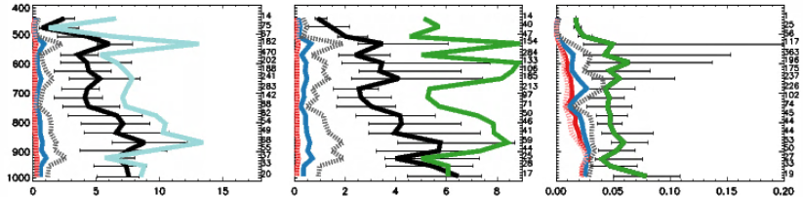
VOC vertical profiles over western US (WE-CAN)
Formic acid
Acetic acid
Lumped C ≥ 3 aldehydes
PTR-ToF-MS observation
TOGA observation
I-CIMS observation
GEOS-Chem + GFED4
GEOS-Chem + GFAS
GEOS-Chem + QFED
GEOS-Chem + 3 × GFAS
GEOS-Chem + noBB
Missing photochemical production source for formic acid, acetic acid, and lumped C ≥ 3 aldehyde

Slide 17
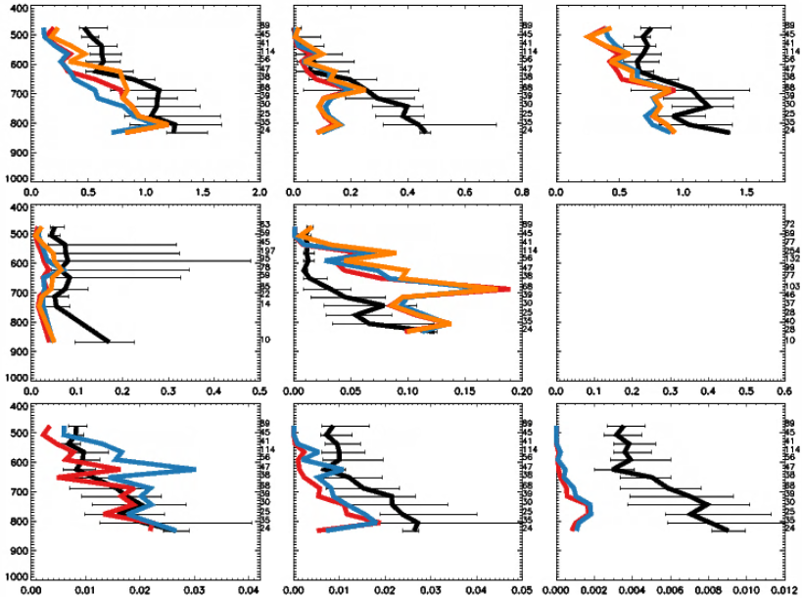
VOC vertical profiles over western US (least-fires region for WE-CAN)
Formaldehyde
Acetaldehyde
Acetone
Propane
MEK
C-130 observations
TOGA observation
GEOS-Chem + GFED4
GEOS-Chem + GFAS
GEOS-Chem + QFED
Pressure(hPa)
Benzene
Toluene
Xylenes
Mixing ratio (ppb)

Slide 18
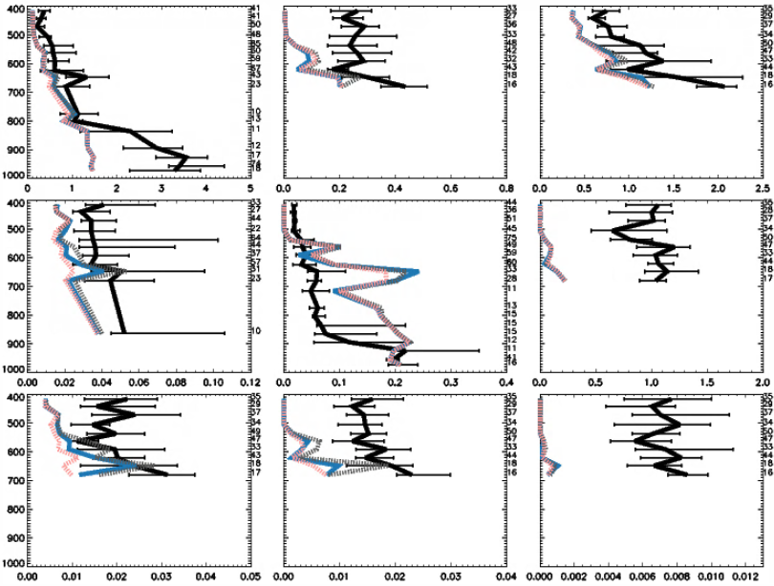
VOCs vertical profiles over the western US (least BB-impacted for FIREX-AQ)
Formaldehyde
Acetaldehyde
Acetone
Propane
MEK
DC-8 observations
GEOS-Chem + GFAS
GEOS-Chem + 3 × GFAS
GEOS-Chem + noBB
Pressure(hPa)
Benzene
Toluene
Xylenes
Mixing ratio (ppb)
There are problems beyond BB emissions as suggested by the relatively clean environment: missing HCHO, acetaldehyde, propane, benzene, and toluene.

